Slide 1
Evaluating deep learning models for electricity price forecasting
Mia Zdybek

Slide 2

About me
Mia Zdybek
Svea Solar
KTH
Planning/admin
App support
Developer intern
Bachelor of Engineering – Engineering Physics
Master of Engineering –Machine Learning

Slide 3

Agenda
Introduction to the problem of the thesis
Machine learning
Method
Results
Conclusions

Slide 4
1. Introduction to the problem

Slide 5


Motivation
Benefits of spot price prediction
Improved strategies for purchasing and selling electricity (financial gain)
Plan production and consumption so that losses are minimized, and grid balance is kept (sustainability)

Slide 6
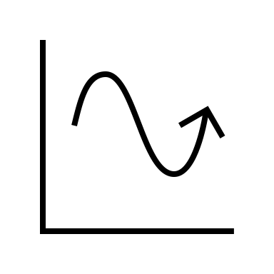
Objective
Find a machine learning model that can predict spot prices 10-days ahead with good accuracy
But why is this beneficial for SVEA?
Only prices one-day ahead are accessible
With 10-days ahead, optimize SVEA end-customer consumption and battery use

Slide 7



Problem
Electricity spot prices are unstable
Electricity spot prices depend on electricity demand and supply (and bidding strategies)
Demand and supply depend on unstable parameters:
- Weather
- Seasonal/societal behavior (holidays, weekly/monthly behavior)
- Politics
- Power source
- Transfer bottlenecks

Slide 8
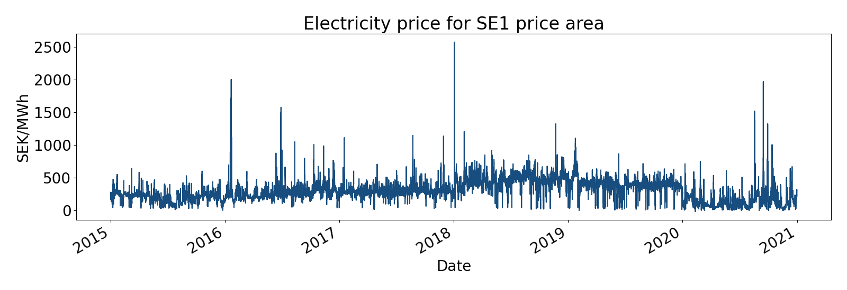
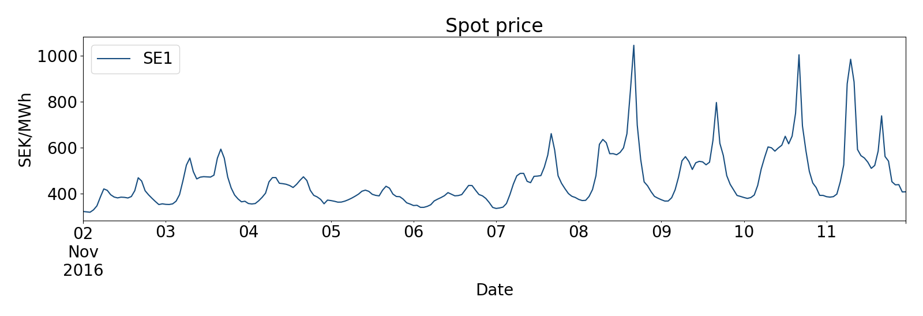
Spot prices
6 years
10 days

Slide 9


Electricity in Sweden
Renewable energy sources are increasing (woho!)
This makes prices more fluctuating

Slide 10
2. Machine learning

Slide 11
What is machine learning? Definition
AI – agent that wants to maximize chance of success in a goal
Artificial Intelligence
Machine Learning
ML - Algorithms based on mathematical models, enables the AI to learn over time
Deep learning - Advanced, more complex ML algorithms
Deep Learning
Used in this thesis

Slide 12


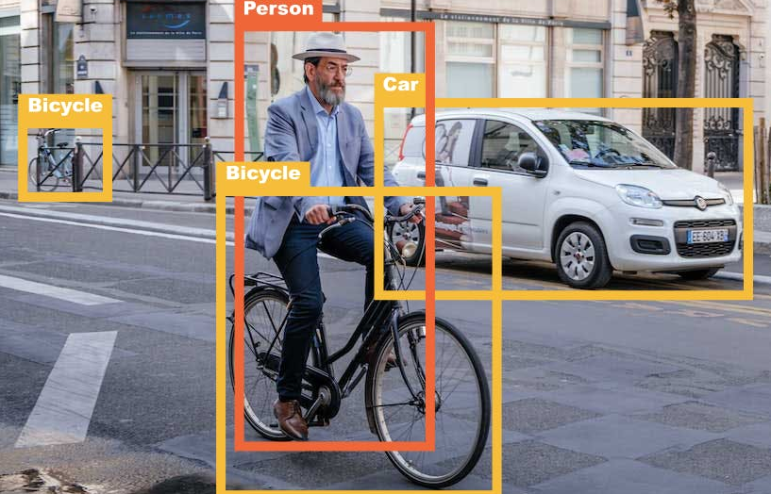

Machine Learning

Slide 13






Supervised learning
Using the model
Training
Data
Model
Output
Truth value
Layer 1
Layer 2
This is basically how most machine learning models are obtained
Bird
Node
Node
Car
Flower
Bird
Bus
Node
Flower
Deep models = more layers
Node
Node
Mathematical operations

Slide 14
ML for time series
Works the same way!
Layer 1
Layer 2
Instead of birds, spot prices.
Node
Output
Truth values
Error
3
5
4
10
6
3
5
2
Node
3
5
4
10
6
3
5
2
Node
5
4
8
5
3
8
0
-1
0
Node
=
Node
Node
5
3
8
Node
Truth values we want to predict

Slide 15
3. Method

Slide 16

Method
Method:
Gather relevant data
Build three different deep learning models
Evaluate them against each other to find best one
Fulfills objective!

Slide 17






Data set
Nord Pool data
SMHI weather data
Calendar variables

Slide 18
Short about the models
MLP
= Multi-layer perceptron
LSTM
= Long Short-Term Memory
CNN
= Convolutional Neural Network
Information flows in one direction like in the examples before
Has a memory since data recurs back to the same node
Like the first model, but summarizes a few inputs simultaneously

Slide 19
4. Results

Slide 20
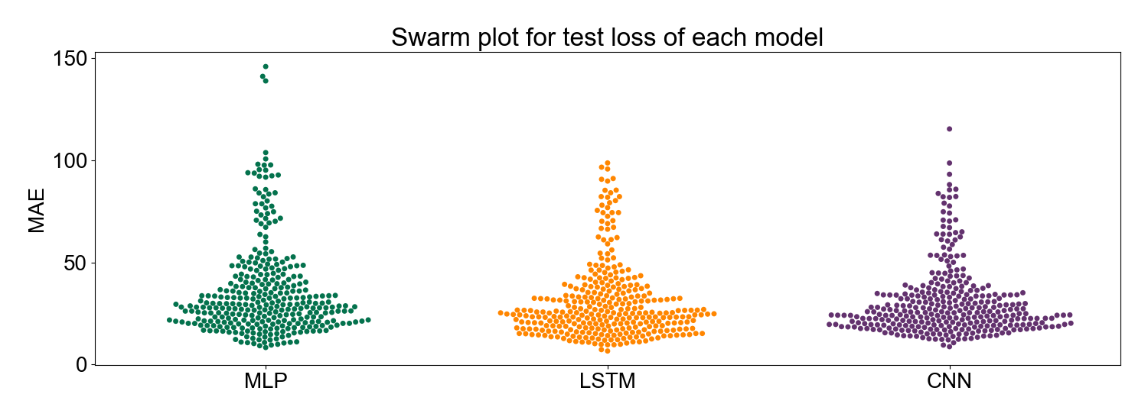
Resulting performance
LSTM and CNN best

Slide 21
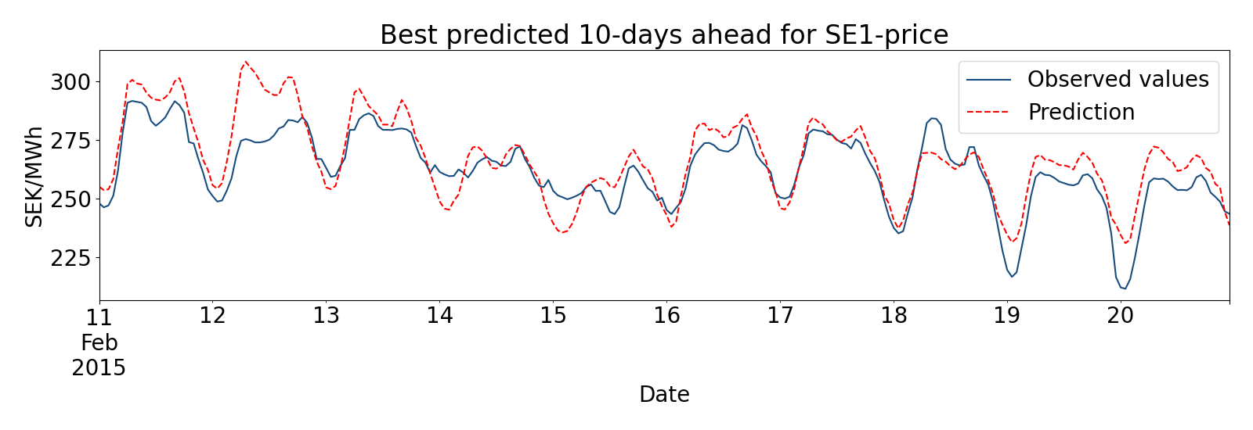
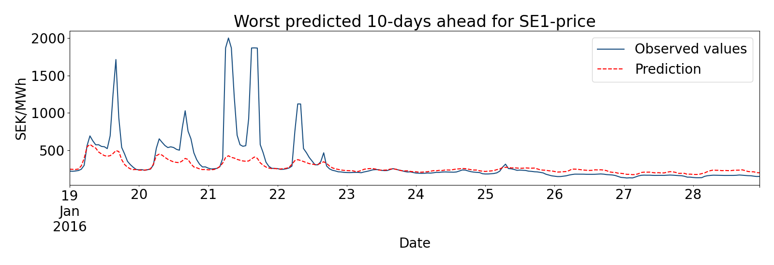
Resulting predictions LSTM

Slide 22
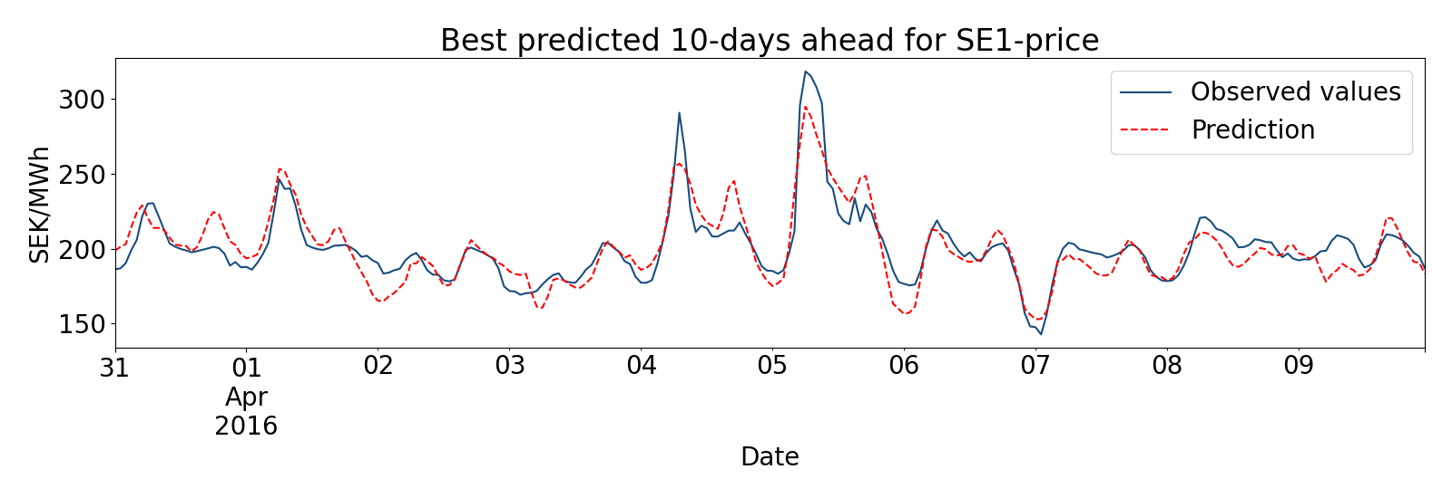
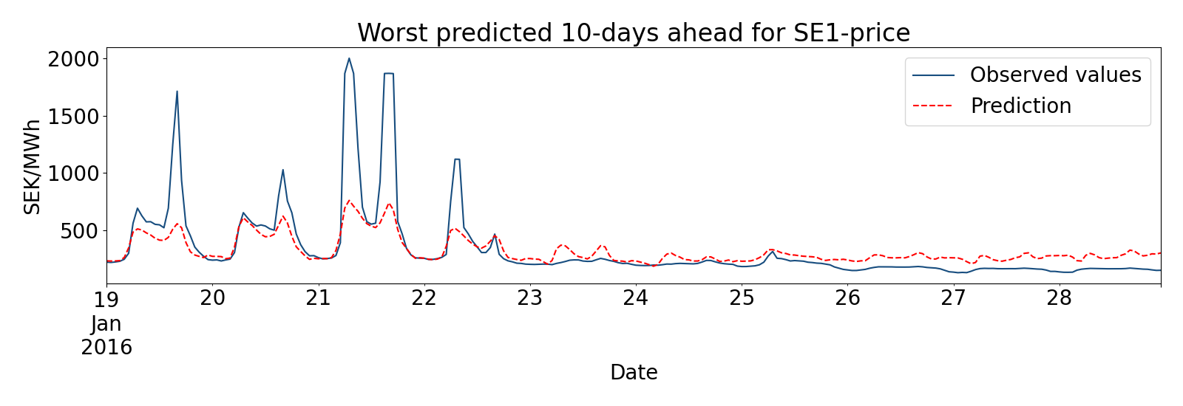
Resulting predictions CNN

Slide 23
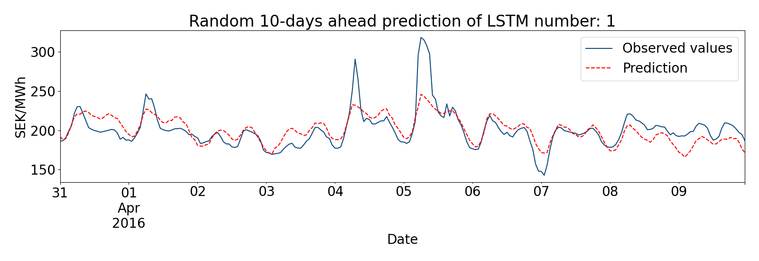
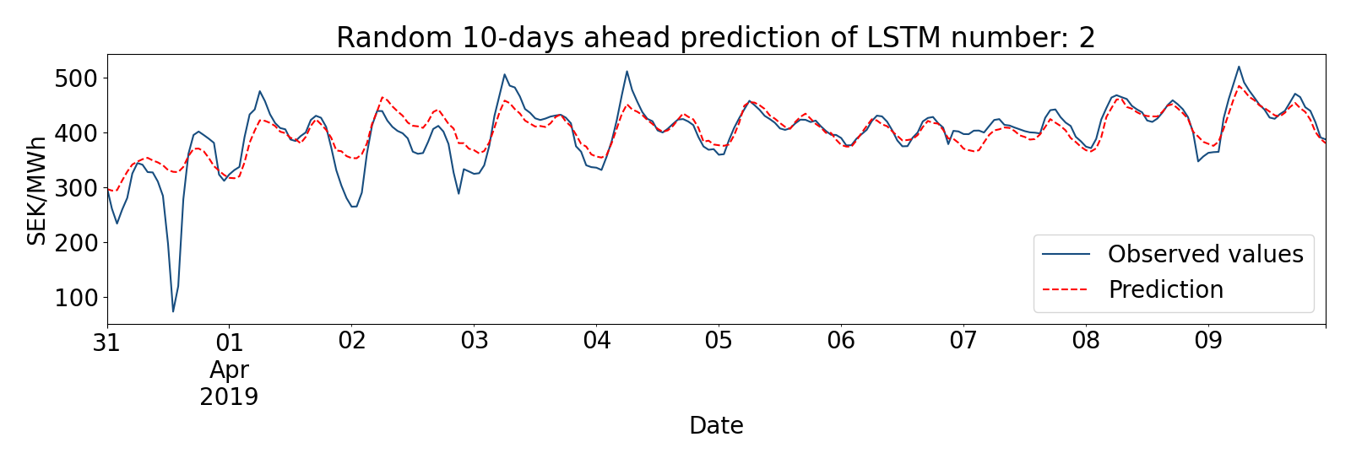
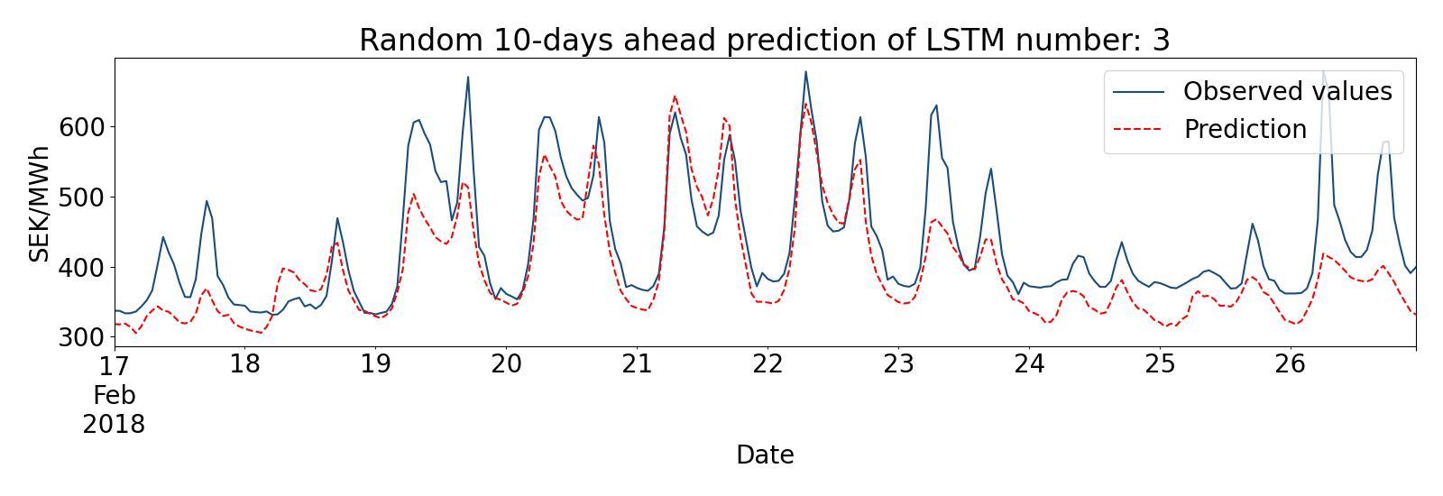
Randomly selected predictions LSTM

Slide 24
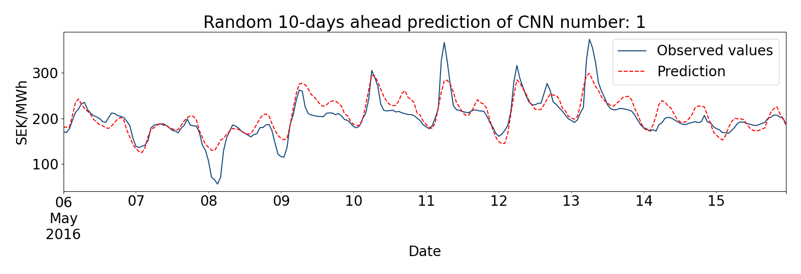
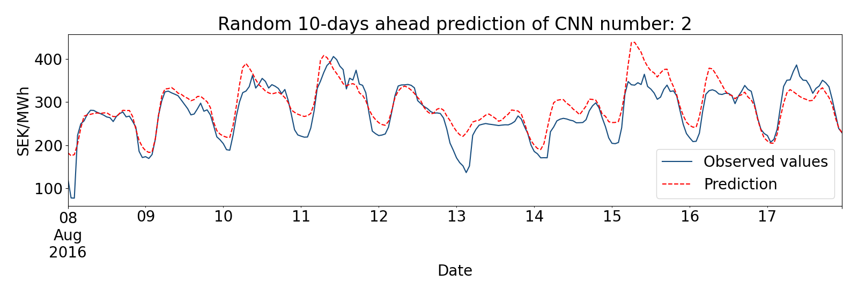
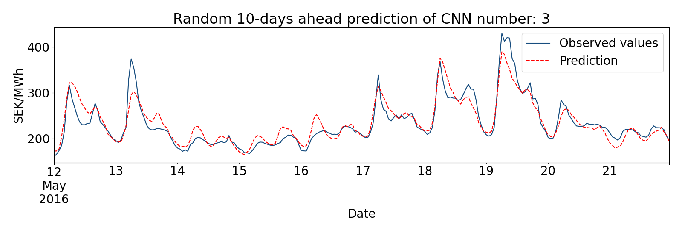
Randomly selected predictions CNN

Slide 25
5. Conclusions

Slide 26

Conclusions
These deep learning models can predict prices with high accuracy, except for the most extreme sudden peaks.
Deep machine learning models perform well in these kinds of tasks, containing numerous complex variables. Applications are many
For SVEA this could mean: - Predicting which customers close - Predicting the production of a solar cell plant - VPP

Slide 27

Future work
With more time, models can be tweaked for even better performance
Especially, we need to examine the peaks more
Analyzing used variables, perhaps remove/add

Slide 28

Thank you!

